Slide 1




A Smart Calendar Assistant Powered by NLP
Empowering Daily Life
Wed (Evening) Group 3
Austin Shenghao XU
Inna Jingyi ZHOU
Teddy Ai RYU
Md Naieem Al Zaman

Slide 2
Our Mission: Making Calendar Management Smarter
Develop a smart assistant that understands natural language commands for managing daily schedules, from adding and rescheduling events to cancelling tasks with ease.

Slide 3
Exploring Two Paths: MobileBERT vs TinyLLaMA
Aspect | MobileBERT | TinyLLaMA
Task Handling | Structured calendar commands with high precision. | Handles complex, multi-step commands effectively.
Accuracy | 99% in structured commands, both relative and absolute temporal expressions. | 96.4% in intent recognition, strong in JSON-like structured outputs.
Complexity Handling | Suitable for simple, well-defined tasks. | Excels in nuanced, multi-command tasks.
Data Output | Standard command responses. | JSON-like structured outputs, ideal for complex data parsing.
Integration | Frontend (Flutter) and Backend (Flask). | Model-focused, no frontend/backend integration.
Ideal Use Case | Quick, single-command tasks (e.g., "Add meeting tomorrow at 3 PM"). | Multi-step, nuanced requests (e.g., "Reschedule lunch with John to next Monday and remind me an hour before").

Slide 4
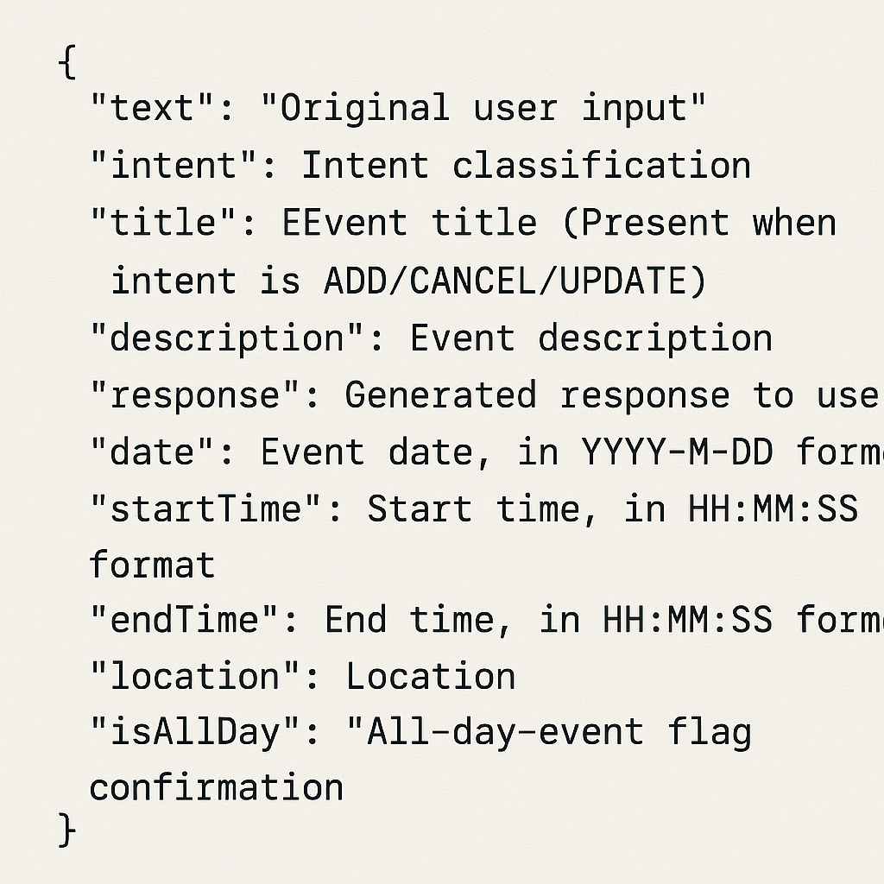
TinyLLaMA Dataset overview & schema
Dataset Origin: Fully synthetic schedule-assistant dataset generated by GPT-O3
Total Rows: 50,000 English examples
Date Range: 1 January 2024 to 31 December 2026
Data File Format: CSV format.
Train/Validation/Evaluation Split (8 : 1 : 1):
Fine-tuning: 40,000 rows (80%)
Evaluation: 5,000 rows (10%)
Validation: 5,000 rows (10%)

Slide 5
End-to-End Fine-Tuning & Evaluation Pipeline
Data Pre-processing
Raw CSV
Clean emoji & symbols
ISO dates/times
ChatML wrap
Convert to JSONL
Tokenise
Push to HuggingFace repo
Fine-tuning &Validation
Attach LoRA
Load Base TinyLlama
Tokenised data
Fine-tuning
Load Evaluation DataSet
ChatML token & Tokenize
Load Fine‑tuned Model
Generate Predictions
Parse & Validate JSON
Generate metrics
Evaluation

Slide 6
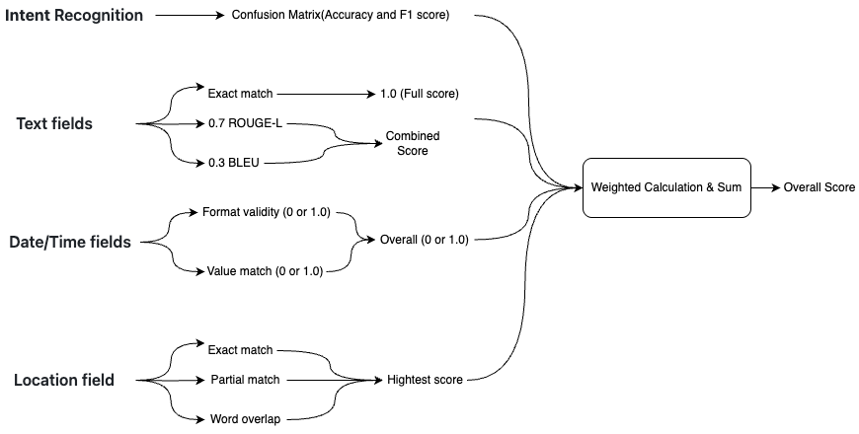

Comprehensive Evaluation & Aggregation Metrics

Slide 7
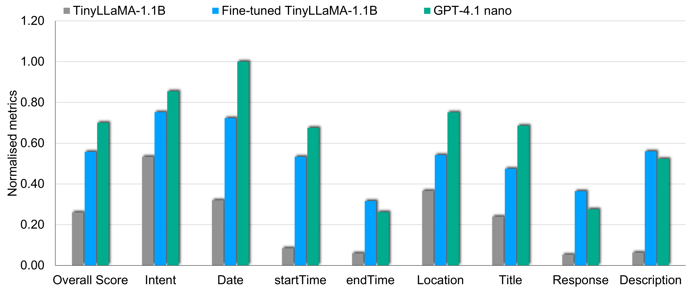
Base Model vs Fine-tuned Model vs GPT-4.1 nano

Slide 8

Meet the Team
Inna
Developed and fine-tuned MobileBERT for intent classification and entity recognition.
Integrated MobileBERT with a backend Flask API and frontend Flutter interface.
Achieved 99% accuracy in parsing structured calendar commands.
Austin
Fine-tuned TinyLLaMA for handling complex, multi-step commands.
Implemented JSON-like structured responses for advanced scheduling tasks.
Improved 114% overall score and 42% intent accuracy.
Teddy
Consolidated technical contributions into a comprehensive report.
Integrated both implementations into a cohesive project narrative.
Coordinated presentation flow and delivery.
Md Naieem Al Zaman
Supported team morale and provided solutions when needed.

